Slide 1

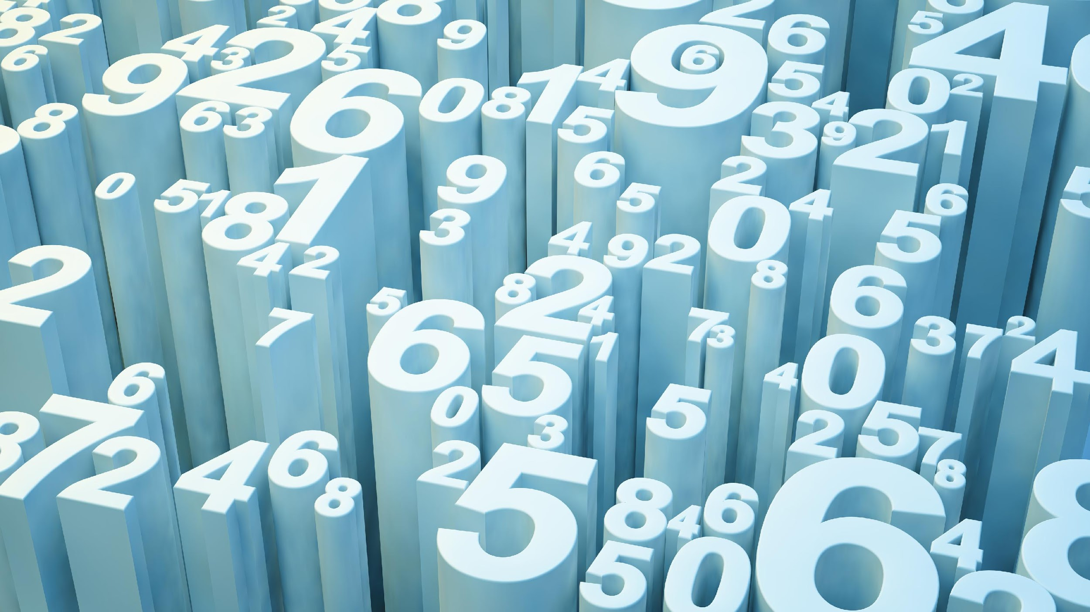
An In-depth Analysis of Polls & Polling: By the Numbers
Group 4
Trey Griffin David Cook-Francis Grant Grossman Aakash Rahman Michael Peyser David Debrowski

Slide 2

Core Message & Hypothesis
By compiling the national polling data from the past 3 Presidential Elections starting with 2008, we can, with a high degree of accuracy & certainty, predict the winner in almost all 50 states. This can be done consistently, within a +-5 point margin of error. We will convey these findings utilizing both data analysis and visual representations. We will discuss the accuracy of pollsters on both a state and national level. Historically, national polling is both less expensive and more accurate than its statewide counterparts and our chosen data sets reflect that sentiment accordingly. Each of these methods still plays an integral role in the overall prediction of election results.
With this in mind, we will also make a prediction regarding the 2020 election, deploying some of the very same techniques used in prior polls in elections to announce our winner.

Slide 3
Questions & Data
Q1: Have national polls been accurate in the past?
Q2: Why was Hillary Clinton expected to win the 2016 election & were there widespread polling errors?
Q3: Based on polling as of today, who is likely to win the 2020 election?
Q4: In our current data centric society, are there other accurate ways to predict who will win elections other than polls?
Notes:
A1: The short answer is yes!
- In 2008, polls predicted a strong lead for Barack Obama going into election day
that wasn’t relinquished.
- In 2012, polls predicted a tight race that Obama eked out on election day.
- In 2016, polls predicted a 4 point win nationally & ended up winning the popular
vote by 2 points.
A2: All data pointed to a win for Clinton. However, given the margin of error associated with these polls, they are still considered accurate even if the end result favors the candidate who was predicted to lose. In 2016, only Wisconsin & Iowa ended up outside of that margin of error. So in many states that were predicted to be close races going to Clinton, they subsequently went to Trump by the narrowest of margins.
A3: Polls currently show Joe Biden with a commanding lead in swing states & an 8 point lead nationally. States that Trump narrowly won in 2016, have him significantly trailing Biden in 2020.
A4: Online betting websites like predictit.com, allow individuals to buy shares in each of the presidential candidates, based upon their standings in the polls.There appears to be a correlation between money spent/risked & the quality/accuracy of data. The process associated with this is considered as accurate as traditional polling data.

Slide 4
Acquiring & Cleaning the Data
Pulled polls from major national and state level pollsters (ABC News, NY Times/Sienna College, Monmouth University et al) for the years 2008, 2012, 2016, and 2020.
Downloaded a complete dataset of the 2016 and 2020 polls from data.fivethirtyeight.com.
Built a national presidential polling dataset that included data from 2008 to 2020.
Built two datasets for 2016 and 2020 that broke data down to the state level so that they could be built into heat maps.
For more details, please, reference the code comments in our Github repository

Slide 5
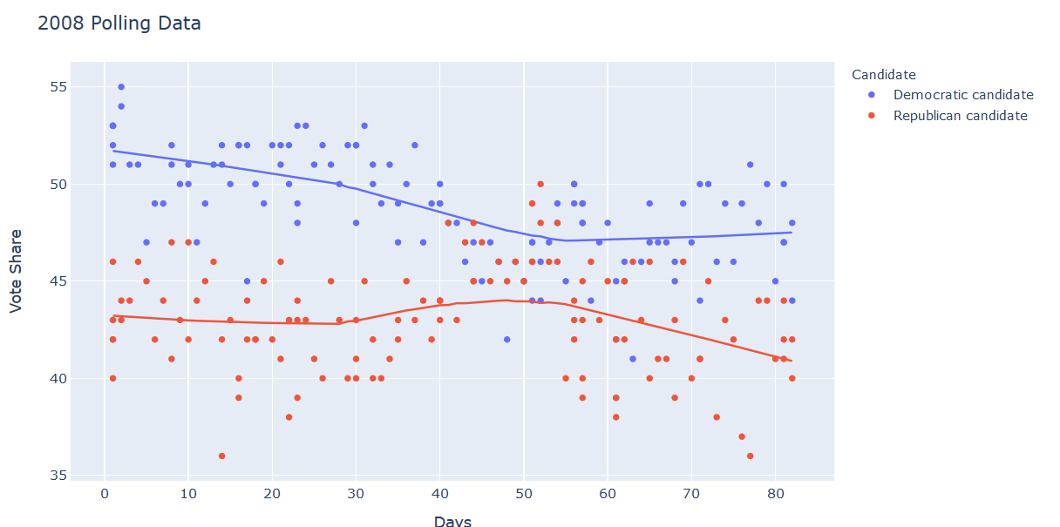
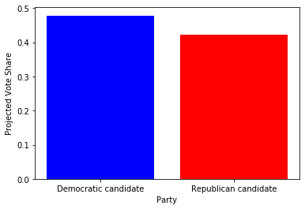
2008 Election Polling Analysis

Slide 6
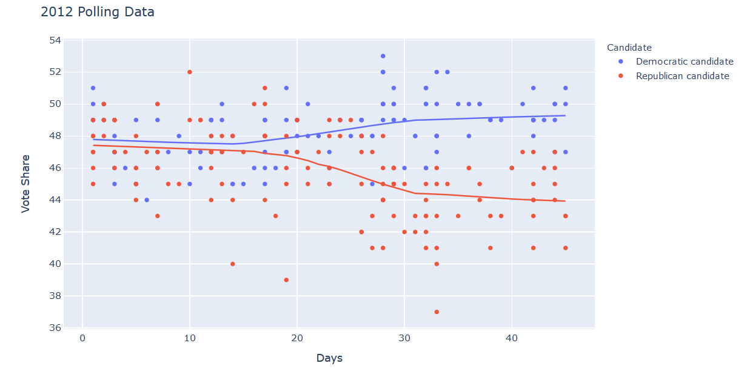
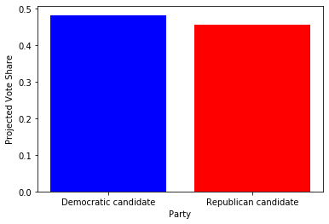
2012 Election Polling Analysis

Slide 7
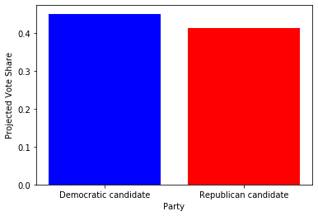
2016 Bar Graph
It predicted HIllary would win the national popular vote and she did! Hurray for her! No, wait a second...

Slide 8
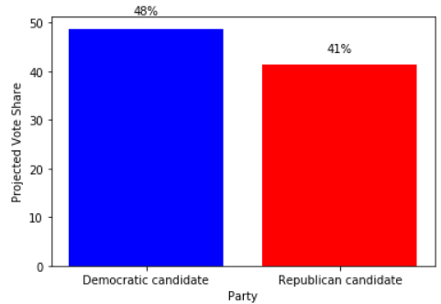
2020 Bar Graph
Notes:
Big lead for Diamond Joe going into 2020! But a national polling lead doesn’t guarantee victory! :(

Slide 9
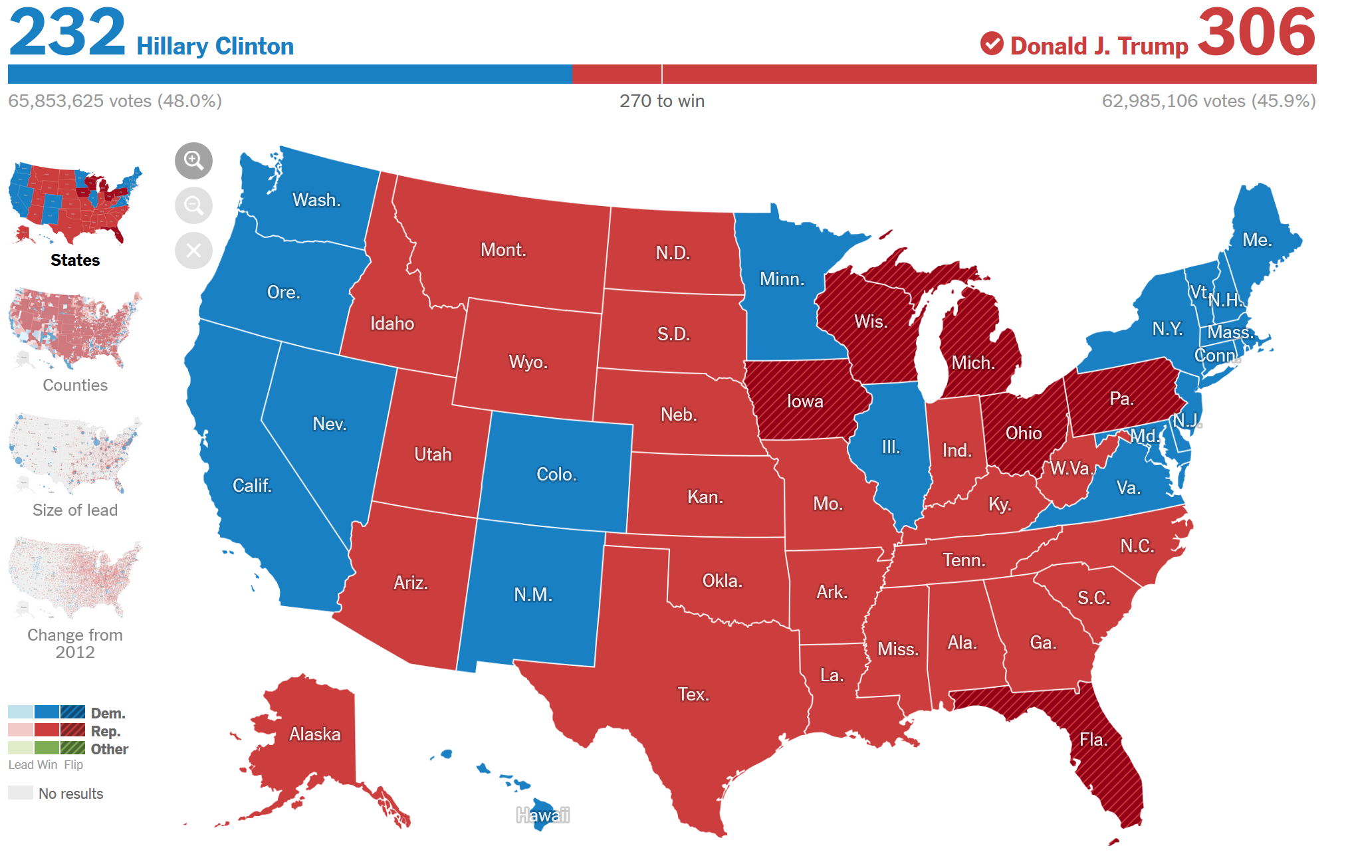
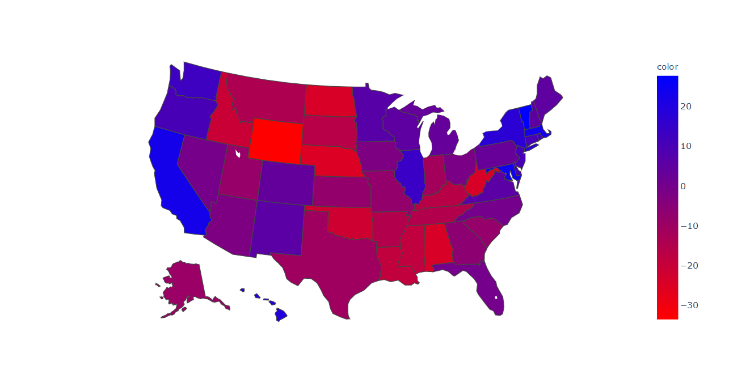
2016 Heat Map + Actual Election Outcome
FL: Trump 0.9%
PA: Clinton 3%
MI: Clinton 3%
OH: Trump: 1%
All of these averages are within a 5 points of the actual outcome!
Snip the heatmap, and put a text box over states that were predicted to go to Hillary and didn’t and what the polling average says her lead was. https://www.nytimes.com/elections/2016/results/president
Notes:
https://www.nytimes.com/elections/2016/results/president

Slide 10
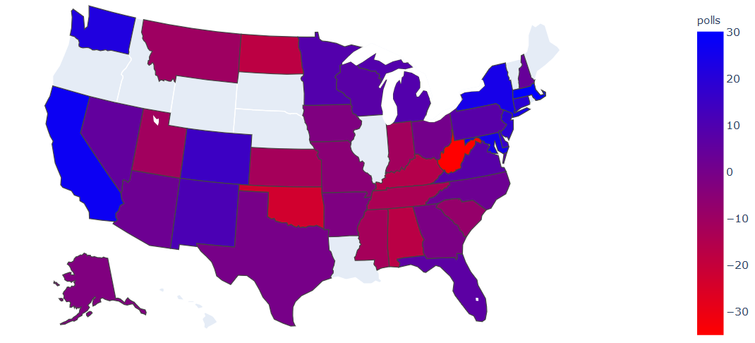
2020 Heat Map + Our Prediction
2016
2020
Notes:
Biden holds significant leads over Trump in Florida (6 points), Michigan (9 points), Wisconsin (7 points), and Pennsylvania (8 points). Biden also has made traditionally uncompetitive states competitive. This includes Texas, Georgia, North Carolina and Arizona all of which are about even, or with a slight Biden lead. Hillary Clinton NEVER had the sort of polling lead that Joe Biden not only currently enjoys, but has sustained for months now.
To back up our analysis, models for the election such as the JHK forecast and The Economist forecast now rate a Joe Biden landslide as more likely than a Donald Trump win.

Slide 11

Conclusion
Polls are good instruments for capturing a snapshot of an election but are often misunderstood

Slide 12
Q & A

